Slide 1
Domain Presentation
Prepared by team 3

Slide 2
1) Agentic AI LLM
Source: RedHat
Agentic AI can be interpreted as a way of combining automation with the creative abilities of a large language model (LLM); it’s a system that provides an LLM with access to external tools, and algorithms that supply instructions. So there’s very little human intervention going in here.
Retrieval-augmented generation (RAG) is a method for getting better answers from a generative AI application by linking an LLM to an alternate instructed prompt, or an external resource. Agentic RAG takes traditional RAG a step further by enabling the LLM to actively investigate rather than simply retrieve.
While RAG can retrieve answers and provide some context from documentation and datasets it has access to, it relies on manual prompt engineering. Agentic RAG can come up with questions of its own, create context from its memory, and carry out additional tasks without being explicitly asked to do so.

Slide 3
AI Agent Orchestration
Source: IBM
Artificial intelligence (AI) agent orchestration is the process of coordinating multiple specialized AI agents within a unified system to efficiently achieve shared objectives. Multi-agent systems (MAS) emerge when multiple AI agents collaborate, either in a structured or decentralized manner, to solve complex tasks more efficiently than a single agent might.
The orchestrator helps synchronize these specialized agents, ensuring that the right agent is activated at the right time for each task. This coordination is crucial for handling multifaceted workflows that involve various tasks, helping ensure that processes are run seamlessly and efficiently.
Centralized orchestration, Decentralized orchestration, Hierarchical orchestration, Federated orchestration

Slide 4
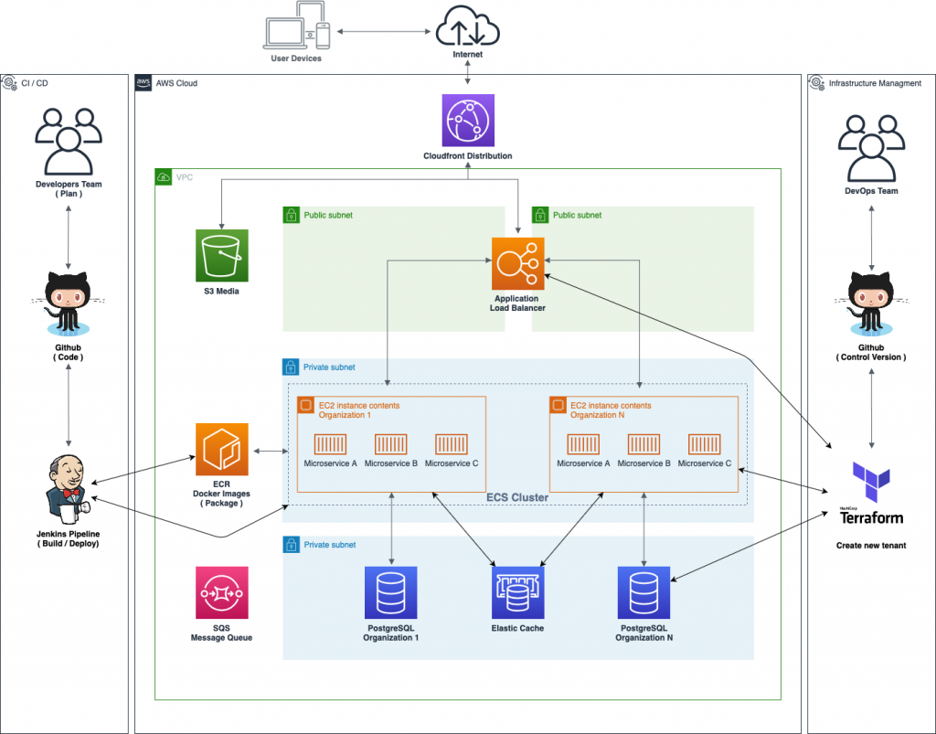
2) MLOps based container multitenant project
• ML Ops (Machine Learning + DevOps) - is a set of practices to streamline &automate end-to-end machine learning lifecycle.
• ML stages are Develop ,Deploy & Monitor used for ML model Development.
• Multitenancy means multiple users use the same system, but each one has their own separate environment.
• Docker (Container)is a software platform that allows you to build, test, and deploy applications quickly.
• A Docker container image is a lightweight, standalone, executable package of software that includes everything needed to run an application.

Slide 5
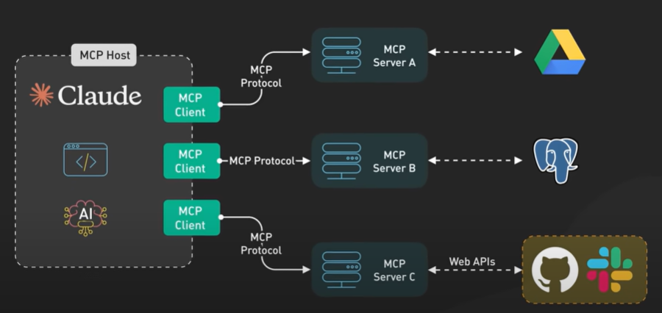
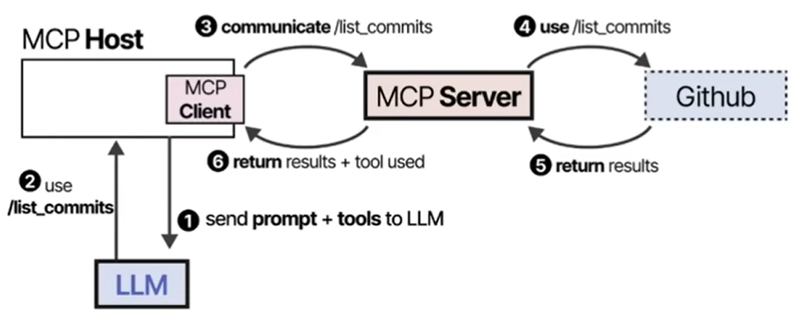
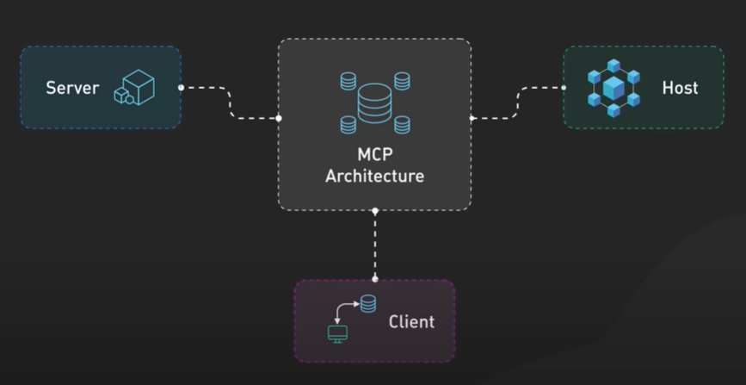
3) ⁠MCP based AI Framework
Benefits of MCP-Based Framework
Personalization: Adapts to user preferences & memory
Grounding: Combines RAG with context for accuracy
Modularity: Easy to add tools, update roles, or switch LLMs
Reusability: Can swap context for different tasks without changing the code.

Slide 6
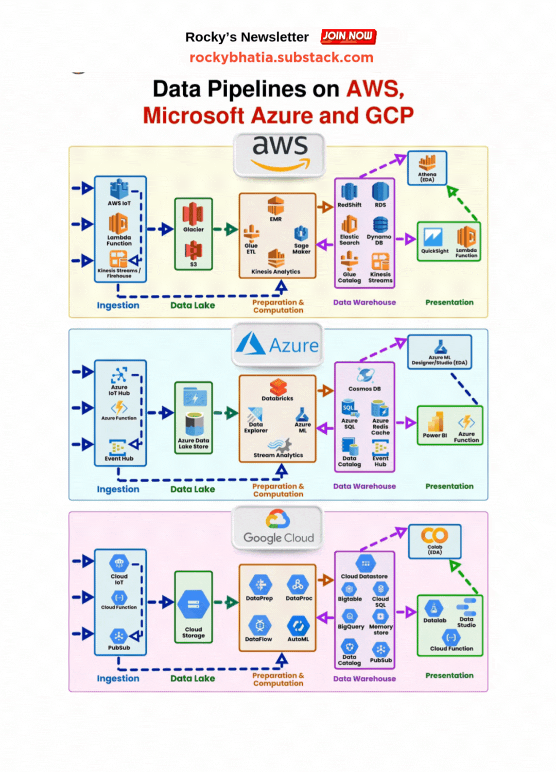
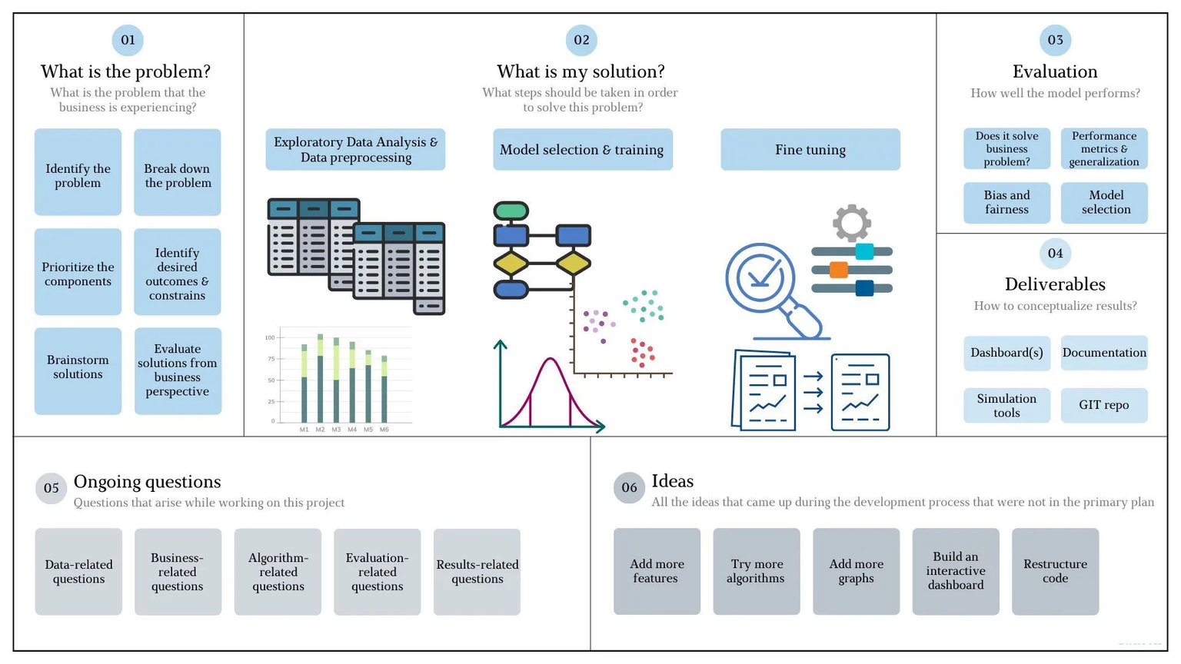
4) AWS , GCP, Azure Pipelines Machine learning model development

Slide 7
Thank you

